Slide 1


Error Detection Techniques using Python
REACT
FASTAPI
Presented By : Satvik Parihar
Batch : D1
Branch : AIDS
Enrollment No. : 23002170510039
Subject : Computer Networks (CN)

Slide 2

The Challenge:
Ensuring Data Integrity
In modern communication, data integrity is paramount.
During transmission across networks, data can become corrupted, Data corruption occurs frequently during network transmission
Noise, interference, and hardware faults introduce bit errors
Corrupted data leads to incorrect processing and unreliable results
Lack of detection mechanisms allows errors to propagate through systems
Ensuring data integrity and reliable communication remains a critical challenge

Slide 3



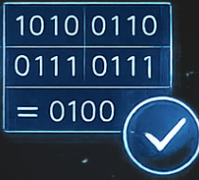
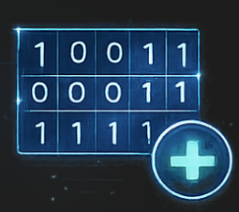
Techniques Implemented in the Simulator
The project provides practical experience with several foundational error detection codes, illustrating their mechanisms and applications in ensuring data accuracy.
VRC
(Parity Bit)
LRC
(Longitudinal Redundancy Check)
CRC
(Cyclic Redundancy Check)
Simplest error detection by adding an extra bit to ensure an even or odd number of 1s.
Adds a parity bit to each column, detecting multiple errors within a block of data.
A powerful technique used for detecting accidental alteration of digital data.
Checksum
Hamming Code
Simple mathematical calculation to detect errors in data blocks.
Not only detects errors but also corrects single-bit errors.

Slide 4
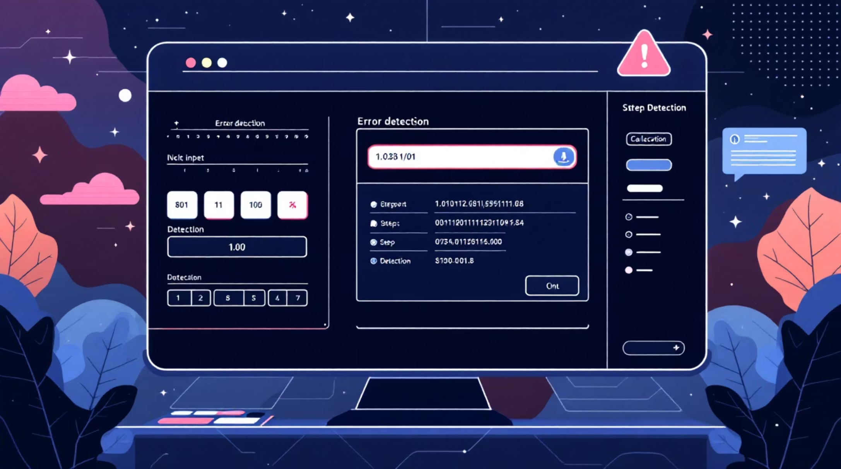
Working & Interactive Features
Enter Binary Data: Users input custom binary sequences for testing.
Automatic Calculation: Selected error detection techniques are applied instantly.
Step-by-Step Detection: Visual breakdown of how errors are identified.
Real-time Results: Immediate feedback on data integrity and error locations.
Clean Interactive Interface: Intuitive design for an engaging learning experience.

Slide 5

Results & Conclusion
Practical Learning
Accurate Implementations
Deepens understanding of error detection concepts through hands-on engagement.
Ensures correctness of error detection algorithms against theoretical principles.
Application
• Interactive visualization of error detection algorithms
• Simulating real-world transmission errors
• Testing data integrity in communication systems
• Supporting research and experimentation

